Slide 1

Oregon Department of Environmental Quality
DMA mapping for Clean Water Act implementation in Oregon
Erin Costello
SORA GIS Tool Talk
September 10, 2026
Notes:
Hi everyone, my name is Erin Costello and I am a senior water quality analyst in the watershed management section at DEQ. I am based out of the headquarters office in Portland, where my team is responsible for developing water quality restoration plans for rivers across the state. In my presentation today, I am going to describe how I use GIS and R tools to map designated management agencies (or DMAs) for Clean Water Act implementation in Oregon.

Slide 2
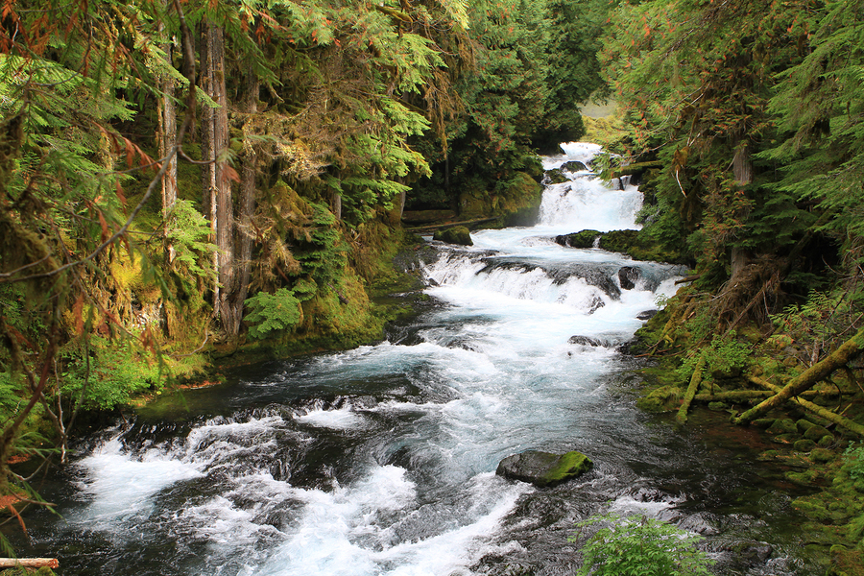
What is a DMA?
A Designated Management Agency (DMA) is defined by OAR 340-042-0030 as:
  “a federal, state or local governmental agency that has legal authority over a sector or source contributing pollutants, and is identified as such by the Department of Environmental Quality in a TMDL.”
Notes:
So, what is a DMA? DMA stands for designated management agency, which is defined by Oregon administrative rules as a federal, state or local governmental agency that has legal authority over a sector or source contributing pollutants and is identified as such by the Department of Environmental Quality in a TMDL.
TMDL is an acronym that stands for Total Maximum Daily Load, which is a water quality restoration plan. This plan is a science-based approach to cleaning up polluted water so that state water quality standards are met. The Clean Water Act requires TMDLs to be developed for all waterbodies not meeting water quality standards. In other words, waterways that are polluted.
Example DMAs include the Oregon Department of Agriculture, the Oregon Department of Forestry, the Forest Service, and cities and counties.

Slide 3
Why map DMAs?
OAR 340-042-0080 (Implementing a TMDL) states:
  “Water Quality Management Plans will identify the sector and source-specific implementation plans required and the persons, including DMAs, responsible for developing and revising those plans.”
The objective is to spatially define the areas that each DMA could potentially have TMDL implementation responsibility over.
Notes:
Now, why map DMAs? The Oregon administrative rule that describes how to implement TMDL states: “Water Quality Management Plans (which are a part of the TMDL) will identify the sector and source-specific implementation plans required and the persons, including DMAs, responsible for developing and revising those plans.”
So, the objective is to spatially define the areas that each DMA could potentially have TMDL implementation responsibility over. Accurately identifying the DMAs responsible for water quality restoration is important for developing effective water quality restoration plans.
DMA maps are useful for developing TMDLs, planning landscape or water quality analysis, and for reporting analysis results. DMA Maps can also improve the communication and visualization of TMDL implementation responsibilities.

Slide 4
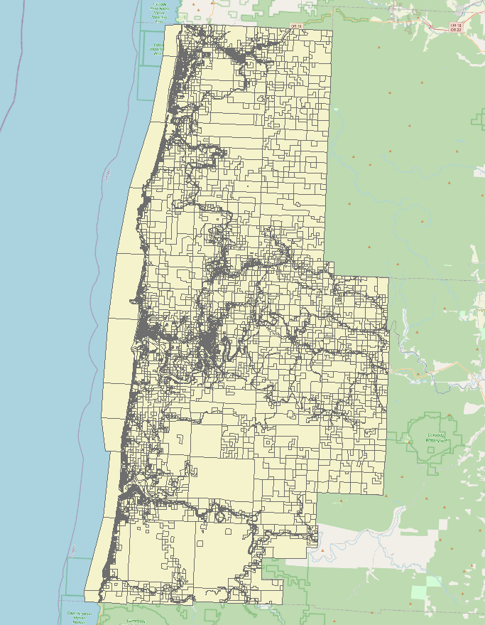
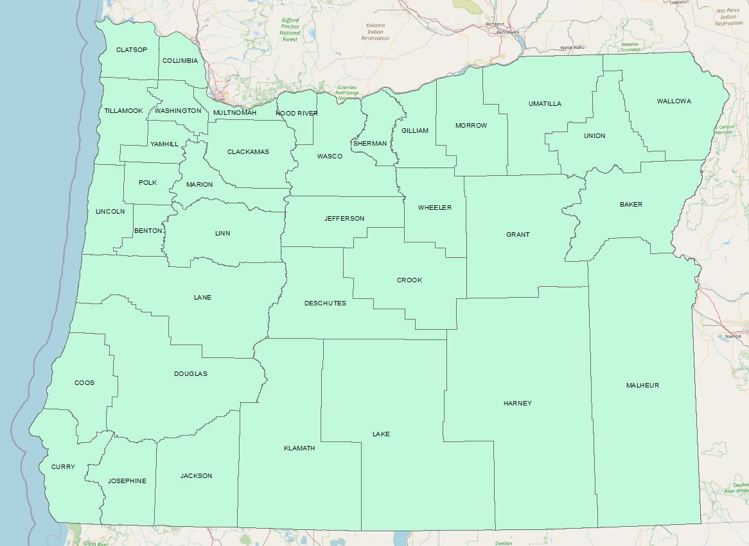
What is the scale of DMA mapping?
Tax lot level
One county at a time
36 counties in Oregon
Notes:
What is the scale of DMA mapping? Dmas are mapped at the tax lot scale which means that every tax lot in Oregon is assigned a DMA. Maps are generated based on county supplied tax lot maps, and each dataset is unique, so one county is mapped at a time. This map on the left shows the tax lot GIS file for Lincoln County. And, the map on the right shows all the counties in Oregon. There are 36, so the DMA mapping process was completed 36 times in order to create a statewide DMA map.

Slide 5
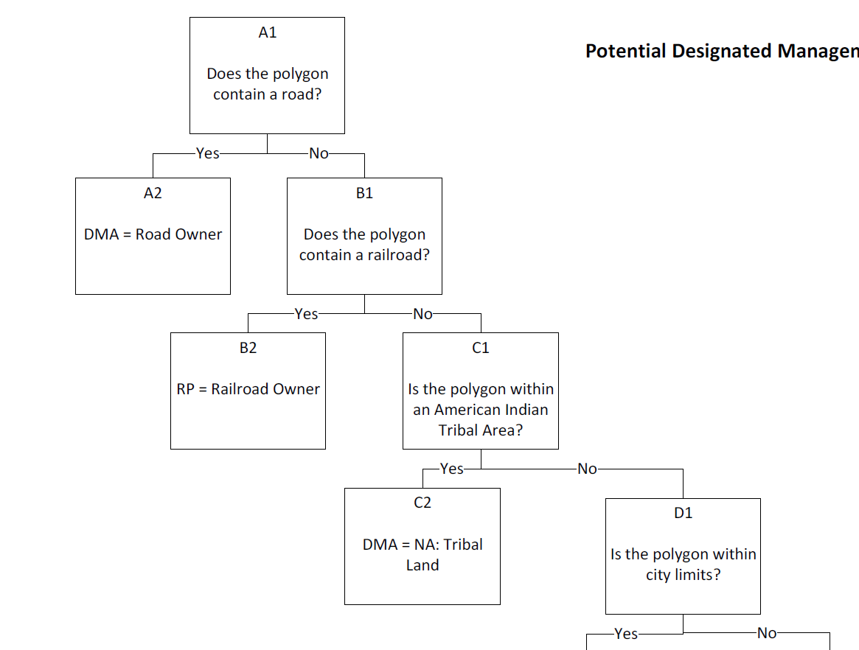
How is a DMA determined?
Each tax lot is assigned a DMA based on the following GIS data:
  Transportation Corridors
  Tribal Land Areas
  City Limits
  Special Districts
  Tax Lot Ownership
  Public Land Manager
  Zoning
  National Land Cover Dataset
Notes:
The DMA for each tax lot is determined based on a combination of land ownership or management information provided by the GIS layers listed on this slide.
For each tax lot, I use GIS data and tools to identify whether a tax lot 1. contains a road or railroad, 2. is within a tribal land area, 3. is within city limits, 4. is owned or managed by a special district (such as a port or public utility), 5. is owned or managed by a DMA, 6. is publicly managed, 7. what the zoning is and 8. what the majority land cover is based on the National Land Cover Dataset.
This information is compiled in the attribute table for each tax lot feature. I then use an R code to read this information for each tax lot and assign a DMA based on a hierarchy of questions that I have diagrammed using a decision tree, part of which shown on the right. First the code checks if the tax lot contains a road, if yes the road owner is assigned as the DMA, if not the code checks if there is a railroad, and so and so forth until the answer that is returned can be used to identify a DMA.

Slide 6
DMA mapping process
DMAs are mapped using a combination of GIS and R data analysis tools.
In general, the steps are:
  Step 1- GIS: Gather GIS base data layers
  Step 2- GIS: Clip base data to a county
  Step 3- GIS: Calculate the majority NLCD land cover type for each tax lot
  Step 4- R: Open DMA mapping script, customize input parameters, join data
  Step 5- R: Run script, assign a DMA to each tax lot, output DMA map as a shapefile.
  Step 6- GIS: Review and edit DMA map, add metadata
Notes:
As I described in the previous slide, DMAs as mapped using a combination of GIS and R tools.
The first step of the process is to gather the GIS base data layers, I use ArcPro.
The second step is to clip all of the base data layers to the extent of the county being mapped.
The third step is to use zonal statistics to calculate the majority NLCD land cover type for each tax lot.
Then for the fourth step I switch to R for analysis. I open the DMA mapping script and customize the input parameters and file names. I then use R to join the base data to the tax lots feature.
At this point, step 5, all the base data information has been compiled into one attribute table and the DMA assignment portion of the code can be run. The output of the DMA mapping script is a shapefile with polygons, and fields of GIS base data and DMA assignment information for each tax lot.
The last step is to review the DMA map shapefile to confirm DMAs and add metadata.
Now I’d like to give a quick tour of what this process looks like in ArcPro and Rstudio.

Slide 7
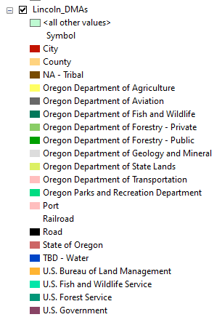
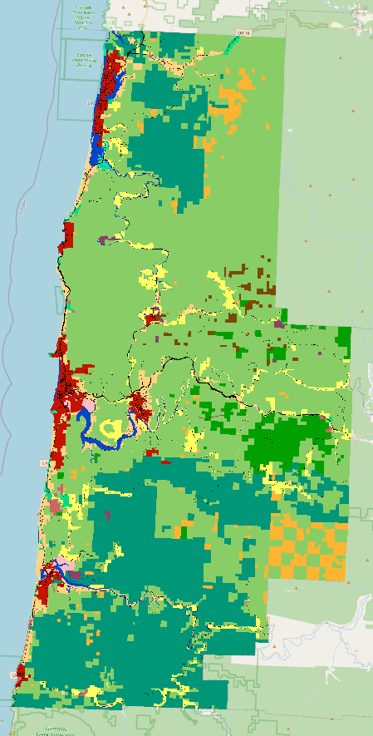
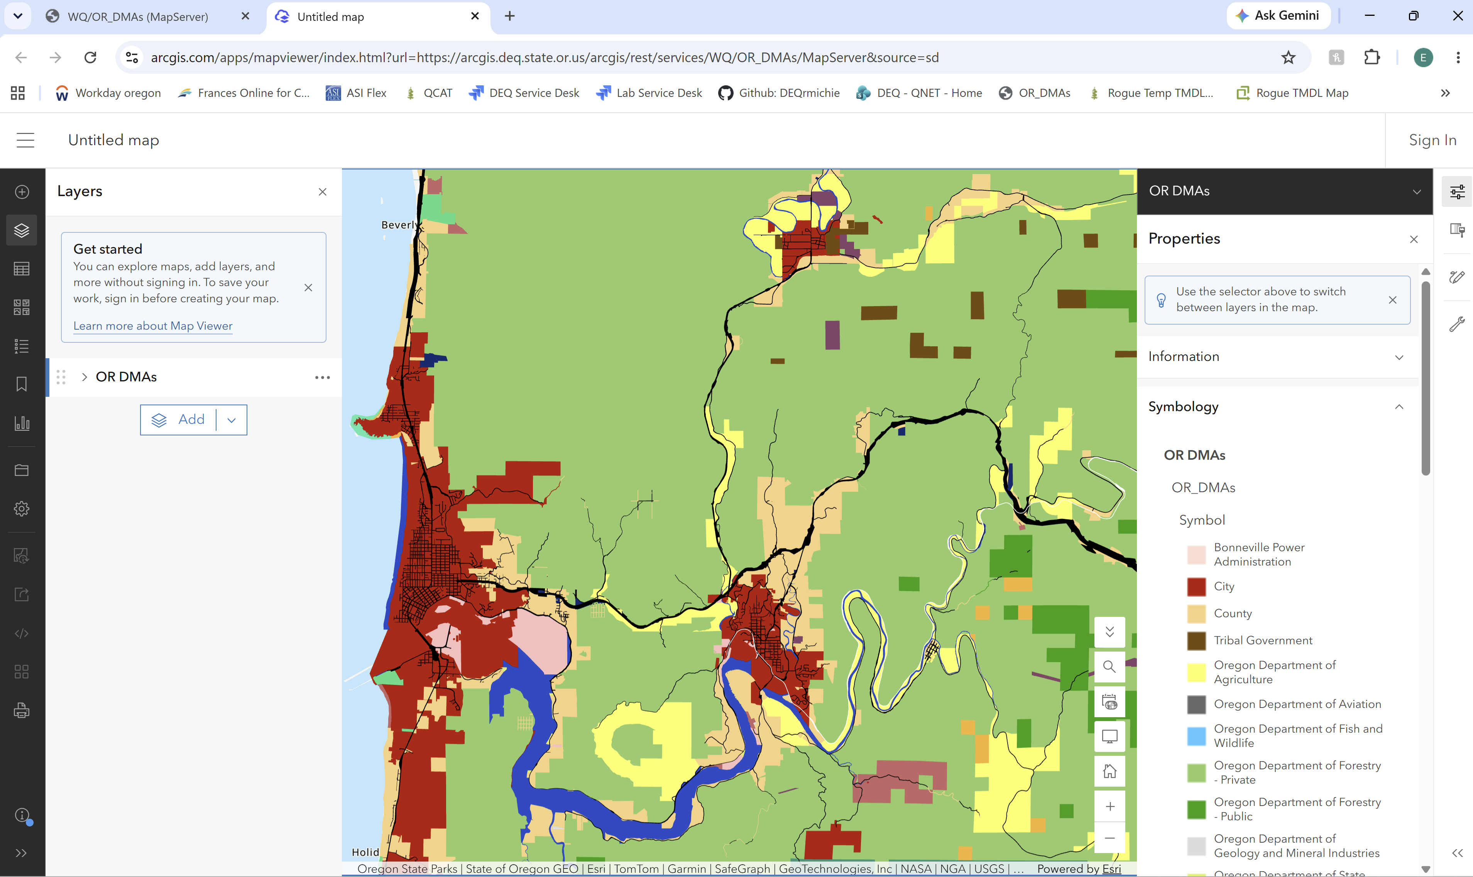
DMA mapping products
GIS features of County DMAs
Statewide feature service of Oregon DMAs
DMA maps
Notes:
As you saw, the output of the DMA mapping process is a shapefile of DMAs for one county. Once this process was completed for all counties in Oregon, a statewide layer was created and is available as a feature service here. This layer has been dissolved so that there is one multipart polygon per DMA. It is still quite a large layer and you need to zoom in for the data to be visible.
Then these county or statewide maps can be used to create other static or interactive maps in support of water quality restoration projects. Let’s look at a few examples.

Slide 8
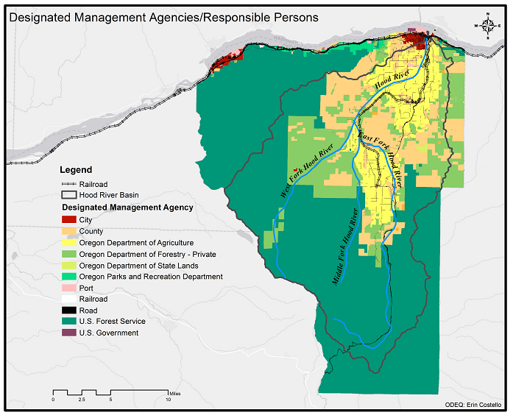
DMA map examples:
Hood River County
Notes:
This is a DMA map for Hood River County created to support local restoration efforts.

Slide 9
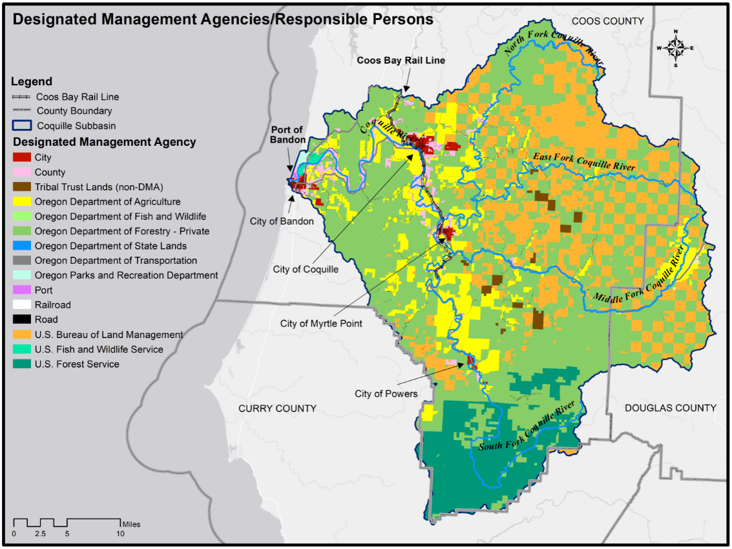
DMA map examples:
Coquille Subbasin
Notes:
This is a DMA map of the Coquille Subbasin created to support TMDL technical development conversations with interested parties.

Slide 10
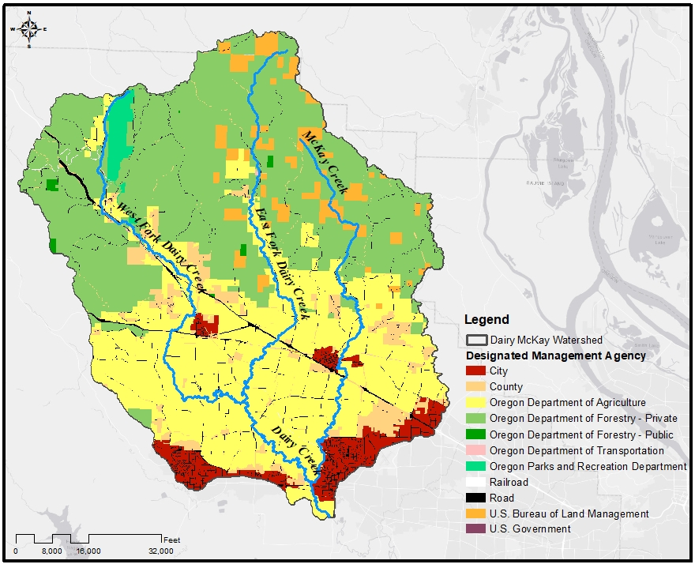
DMA map examples:
Dairy McKay Watershed
Notes:
This is a DMA map of the Dairy McKay watershed to support a grant application for riparian restoration funding.

Slide 11
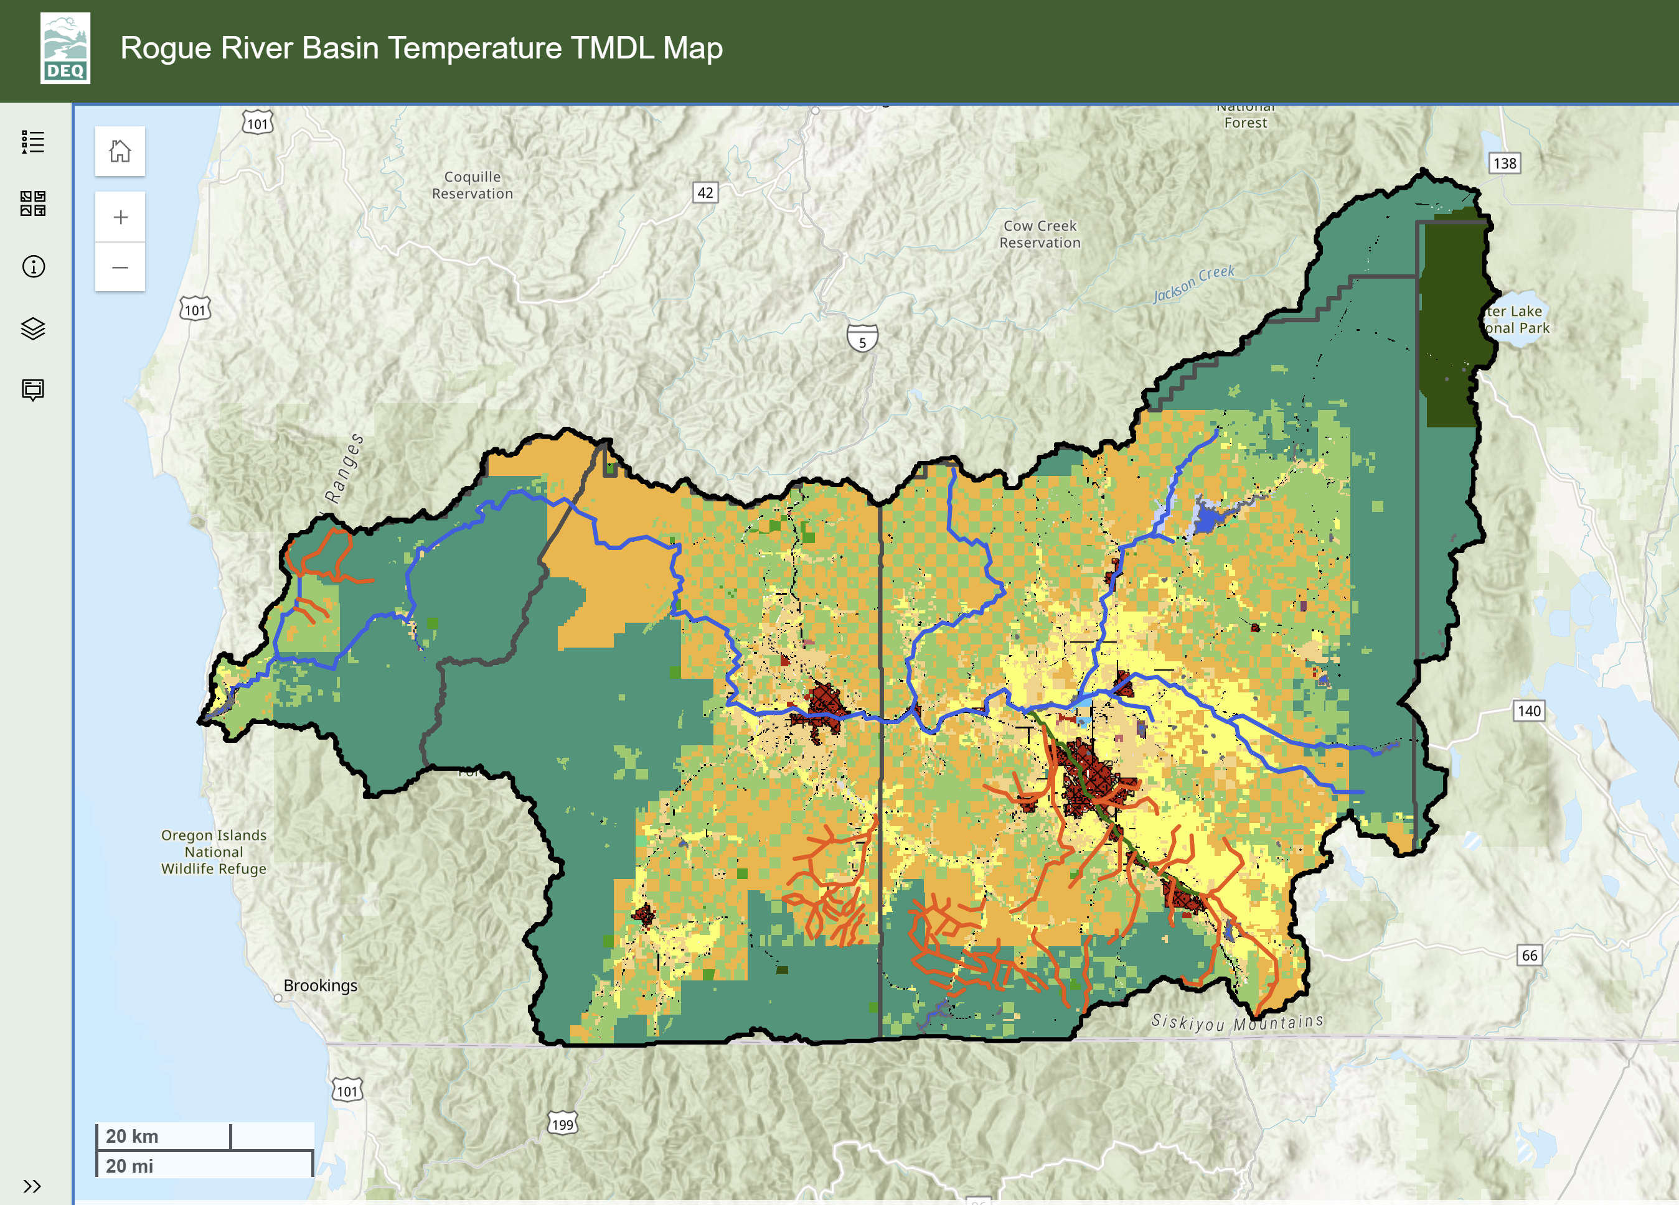
DMA map examples: Rogue River Temperature TMDL Interactive Map
Notes:
This is an interactive map created to support TMDL development for the Rogue River Basin Temperature TMDL. The basin wide DMA map is just one layer of GIS data presented with many others.

Slide 12



Questions?
Erin.costello@deq.oregon.gov
Notes:
And that’s all I have for you today. Are there any questions?

