Slide 1
Digital Accessibility & Inclusion
SORA Winter Webinar (Dec. 5, 2024)
Christine Getman (she/her), Accessibility, Inclusion and Education Unit Manager
Adam McBride-Smith (he/him), Digital Accessibility Strategist

Slide 2
Outline
What is digital accessibility and who needs it?
Models and values
Federal rules and guidelines
Approach to the rules through policies
Policy implementation
Example: Accessibility in Data Visualizations

Slide 3
What is digital accessibility?
Working Definition:
Digital accessibility is an approach to technology and content design that involves thinking specifically about the experiences and needs of people with disabilities. By designing for these needs, and by following the guidance and leadership of people with disabilities, we arrive at technology that works better for everyone.

Slide 4
Who needs accessible content?
Blind and deafblind people
People with low vision
People with color-blindness
People who have motor disabilities
People with cognitive or learning disabilities
Deaf and hard-of-hearing people
Speakers of English as a Second or Additional Language
People with Temporary and Situational Disabilities

Slide 5
Common forms of Assistive Technology (AT) used to access digital content
Screen readers (JAWS, NVDA, VoiceOver, Narrator)
Text-to-speech software (Read Aloud, Speachify)
Speech-to-text software (Dragon Naturally Speaking)
Magnification Software (ZoomText)
Dark mode and other customizable color palettes
Keyboard Access
Switch Devices
Onscreen keyboards

Slide 6
What are Models of Disability?
How disability interacts with medical fields, social culture, educational and government institutions, and the workforce
Sets of beliefs that explain social attitudes and actions toward disability

Slide 7
Applying the models
Medical:
person needs fixing
Charity:
person is a victim
Economic:
person isn’t productive
Moral:
person deserved disability
Social:
society and barriers are disabling
Identity:
person is unique and celebrated

Slide 8
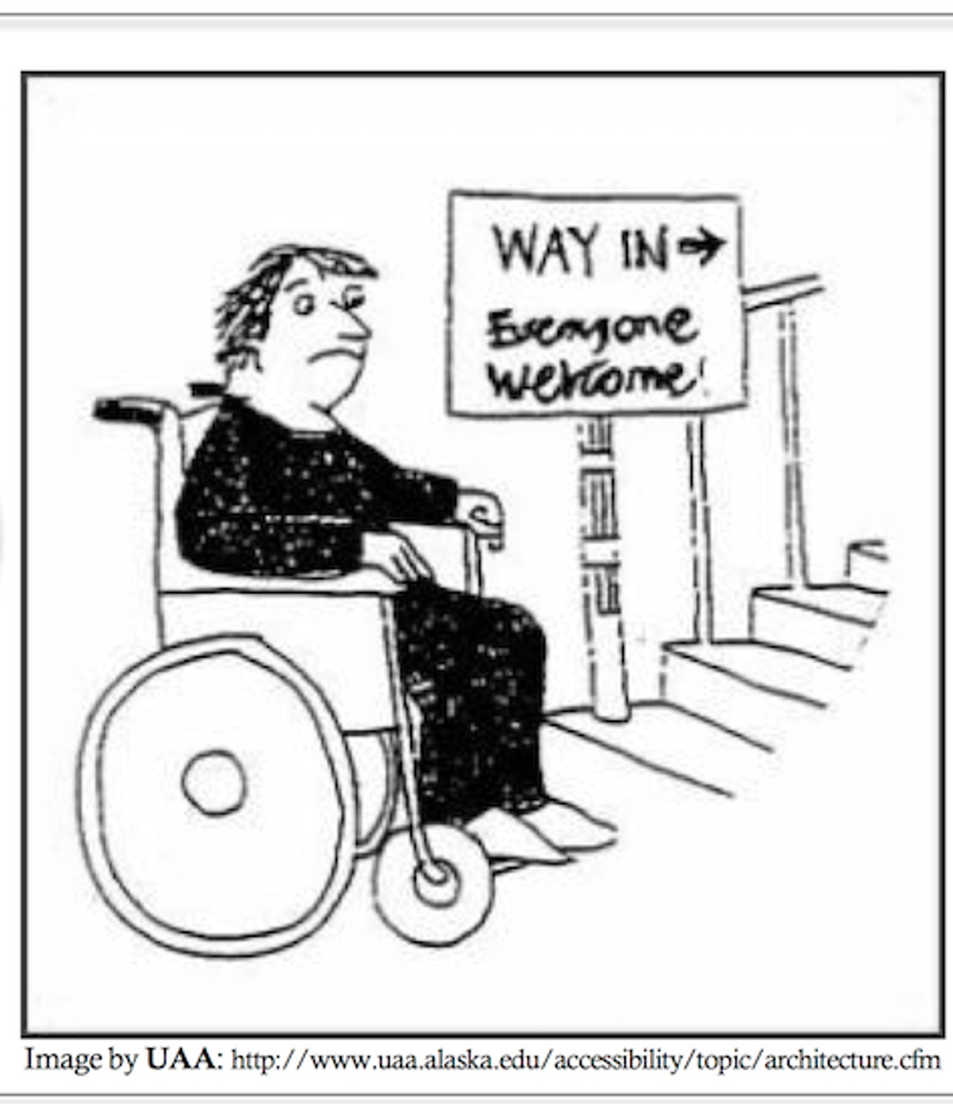
In our work: Medical and Social
Medical Model: The person with the disability is the problem; they need to change (treatment, cure culture)
Social Model: The social or physical environment is a barrier; it needs to change (build ramps, create accessible documents)

Slide 9
Timeline: Federal Rules, guidelines, and agency policies
November 2022: The Digital Accessibility Policy Workgroup (OHA/ODHS) begins meeting
July 25th, 2023: The DOJ’s Notice of Proposed Rulemaking on Accessibility of Web Information and Services of State and Local Government Entities was published (aligned with WCAG 2.1)
October 5th, 2023: WCAG 2.2 becomes the w3c’s recommended standard.
April 24th, 2024: The DOJ’s final rule was published.
May 9th, 2024: A rule on Nondiscrimination on the Basis of Disability Under Section 504, published by the US Health and Human Services Department (HHS).
Notes:
The DOJ’s Notice of Proposed Rulemaking on Accessibility of Web Information and Services of State and Local Government Entities was published on July 25th, 2023, and the DOJ’s final rule was published on April 24th, 2024.
This was swiftly followed by a rule on Nondiscrimination on the Basis of Disability Under Section 504, published by the US Health and Human Services Department (HHS) on May 9th, 2024.

Slide 10
About the new DOJ and HHS Rules
DOJ rule applies to all digital content produced by or for the state of Oregon
  Important note: This includes content that the state procures from vendors.
HHS rule covers all entities that receive federal healthcare money.

Slide 11
Details of the New Rules
Set a technical conformance standard of WCAG (the Web Content Accessibility Guidelines) 2.1 Levels A and AA.
  Provide a 2-year timeline for states (the compliance deadline for the DOJ rule is April 24th, 2026)
  Explicitly cover “conventional electronic documents,” defined as:
    Portable document formats (PDFs)
    Word processor file formats (such as Word docs)
    Presentation file formats (such as PowerPoint presentations)
    Spreadsheet file formats (such as Excel files)

Slide 12
The Web Content Accessibility Guidelines (WCAG)
WCAG: often pronounced “Wi-cag”
Developed by the World Wide Web Consortium (or w3c)
Provides technology-neutral accessibility standards for digital content
Many countries around the world now reference WCAG as a technical standard for digital accessibility
There are four iterative versions of WCAG: 1.0, 2.0, 2.1, and 2.2
There are three conformance levels of WCAG: A, AA, and AAA

Slide 13
More about WCAG
WCAG 1.0 was published in 1999. It was superseded by WCAG 2.0 in 2008, and by WCAG 2.1 in 2017.
WCAG 2.2 was elevated to Recommended status on October 5th, 2023, making it the current standard. WCAG 2.2 has 56 Success Criteria (SCs) at A and AA levels.
All versions of WCAG 2 (2.0, 2.1, and 2.2) are additive and backward-compatible.
Section 508, which covers federal web content, was aligned with WCAG 2.0 (Levels A and AA) in 2017.
The DOJ and HHS rules are aligned with WCAG 2.1 (Levels A and AA).
OHA and ODHS policies are aligned with the most recent Recommended version, WCAG 2.2 (Levels A and AA).

Slide 14
New OHA and ODHS shared policies on Digital Accessibility
Content Creation and Sharing (ODHSOHA 010-029)
Hardware, Software and Systems (ODHSOHA 010-030)
Developed by Digital Accessibility Policy Workgroup over 2 years
Workgroup participants from OHA and ODHS, as well as representatives from DAS, Oregon Broadband, Oregon Commission for the Blind, etc.

Slide 15
Digital Accessibility in Content Creation and Sharing Policy

Slide 16
Content Creation and Sharing Policy
Ensures any form of digital content created by the agency and provided either internally or externally is accessible​
Digital content adheres to Web Content Accessibility Guidelines (WCAG) 2.2 Levels A and AA.​
Includes websites, reports, surveys, dashboards, and documents.​

Slide 17
Digital Accessibility in Hardware, Software and Systems Policy

Slide 18
Hardware, Software and Systems Policy
Requirements for procuring or building ICT solutions in alignment with Web Content Accessibility Guidelines 2.2 (WCAG), level A and AA Guidelines.​
“Information and communications technology (ICT) solutions” describes information technology content, applications, and services​
  All hardware and software​
  Agency or 3rd party created multimedia and electronic content​
  Electronic hardware, software and documents used by ODHS and OHA​

Slide 19
Exception 1: Archived Web Content
Archived web content means content that meets all of the following conditions:
It was created before the date the public entity is required to comply (April 24, 2026), reproduces paper documents created before the date the public entity is required to comply, or reproduces the contents of other physical media created before the date the public entity is required to comply;
It is retained exclusively for reference, research, or recordkeeping;
It is not altered or updated after the date of archiving (minor redactions for purposes of confidentiality are allowed)
It is organized and stored in a dedicated area or areas clearly identified as being archived (this can include a section of a website or page that is designated as an archive, or an entire site or database designated as an archive).

Slide 20
Exception 2: Preexisting Conventional Electronic Documents
Preexisting conventional electronic documents means conventional electronic documents, that is
  portable document formats (PDFs)
  Word processor file formats (such as Word docs)
  Presentation file formats (such as PowerPoint presentations)
  Spreadsheet file formats (such as Excel files)
that are available as part of a public entity's web content or mobile apps before April 24, 2026
UNLESS such documents are currently used to apply for, gain access to, or participate in the public entity's services, programs, or activities.

Slide 21
Other Exceptions
Content posted by a third party where the third party is not posting due to contractual, licensing, or other arrangements with a public entity. (so, a social media post by a 3rd party would be excepted, NOT an app or a website built by a vendor under contract).
Preexisting social media posts (i.e. posted before April 24, 2026)
Notes:
Note that the DOJ rule included an exception for individualized password protected documents. We removed this from our policies on the guidance of the NFB and following the model of the state of Colorado. Note that standard ADA exceptions, such as fundamental alteration, still apply

Slide 22
What we are doing to implement these policies
Launching an Oregon.gov page to communicate requirements, progress, and guidance on digital accessibility: https://www.oregon.gov/oha/Digital-Accessibility/Pages/index.aspx.
Project management support on both the OHA and ODHS sides.​
At OHA, we are working on creating a charter and steering committee.​
The AIE Unit is in the process of hiring to help with digital accessibility.​
Begin surveying and remediating websites, apps, and documents in early 2025 on a division-by-division basis.​
Offer rolling training schedule for accessible content creation in 2025.

Slide 23
Accessibility for Data Visualizations (checklist)
Use clear titles
Include text summaries
Consider moving large blocks of text out of dashboards and onto web pages
Keep it simple
Include easily findable information about accessibility features
Use text that supports readability
Choose colors carefully
Add alt text to meaningful images and objects
If using content that displays only on hover, such as tooltips, ensure that the same information is available elsewhere as real text
Check your focus order early in the process
Ensure that data tables are enabled for data visualizations
Support mobile accessibility and reflow
Choose widgets and elements carefully
Use the latest available version of your platform to take advantage of accessibility-related updates
Retest dashboards after new releases
Learn more about accessibility for data visualizations
  More details available at our Accessible Data Visualizations Quick Guide

Slide 24
Consider moving large blocks of text out of dashboards and onto web pages
​Blocks of text included in a dashboard often can’t be highlighted, copied, searched, magnified, easily translated, or otherwise customized for readability (a WCAG requirement).
Embedding a data dashboard on an HTML websites helps you avoid this problem. See this example from the City of San Francisco COVID-19 data and reports.

Slide 25
Data tables and accessibility
Screen reader users need to be able to interact with data visualizations, and data tables are a common way to make this possible.
In Power BI, data tables are enabled by default. In Tableau Public access to the “View Data” window must be enabled.
It can help screen reader users to be reminded of the key commands for accessibility. For example, Alt + Shift + F11 opens data tables in Power BI.

Slide 26
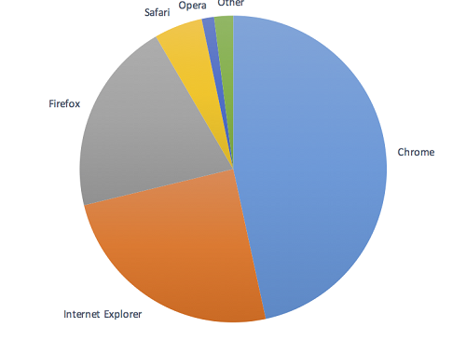
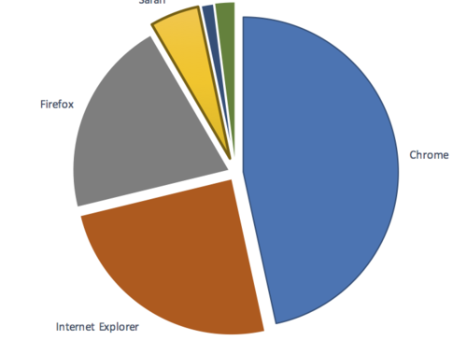
Non-text Contrast – SC 1.4.11 (Level AA)
Cannot discern the edges and low contrast
Visible labels and sufficient contrast

Slide 27
Use of Color – SC 1.4.1 (Level A)
Goal: Color is not the only way of distinguishing information.
__ = missing data
X = missing data
__ = complete
√ = complete
Use information in addition to color, such as shape or text, to convey meaning.

Slide 28
Large Blocks Of Text
Consider moving large blocks of text out of dashboards and onto web pages
Blocks of text included in a dashboard often can’t be highlighted, copied, searched, magnified, easily translated, or otherwise customized for readability (a WCAG requirement).
Embedding a data dashboard on an HTML websites helps you avoid this problem. See this example from the City of San Francisco COVID-19 data and reports.

Slide 29
Helpful Links
OHA’s Accessible Data Visualization Toolkit
A Template for Accessible Data Visualizations from San Francisco Digital & Data Services
​Urban Institute's Do No Harm Guide: Centering Accessibility in Data Visualization
Chartability​: testable questions for ensuring data visualizations are accessible​

Slide 30
Who benefits from digital accessibility?
Who can uphold digital accessibility?
All of us!

Slide 31
You can get this document in other languages, large print, braille or a format you prefer free of charge. Contact Christine Getman at Christine.M.Getman@oha.oregon.gov or 971-610-2240 (voice/text). We accept all relay calls.​
Equity and Inclusion (E&I) Division ​
Civil Rights, Learning and Inclusion (CRLI) Section​
Accessibility, Inclusion and Education (AIE) Unit​
421 SW Oak Street, Suite 750, Portland, OR 97204​
971-673-1240​
https://www.oregon.gov/oha/ei/Pages/index.aspx​

