Slide 1
SORA 2024 Survey Results
Michael Metiva
SORA Chair
January 24, 2024
N = 82

Slide 2
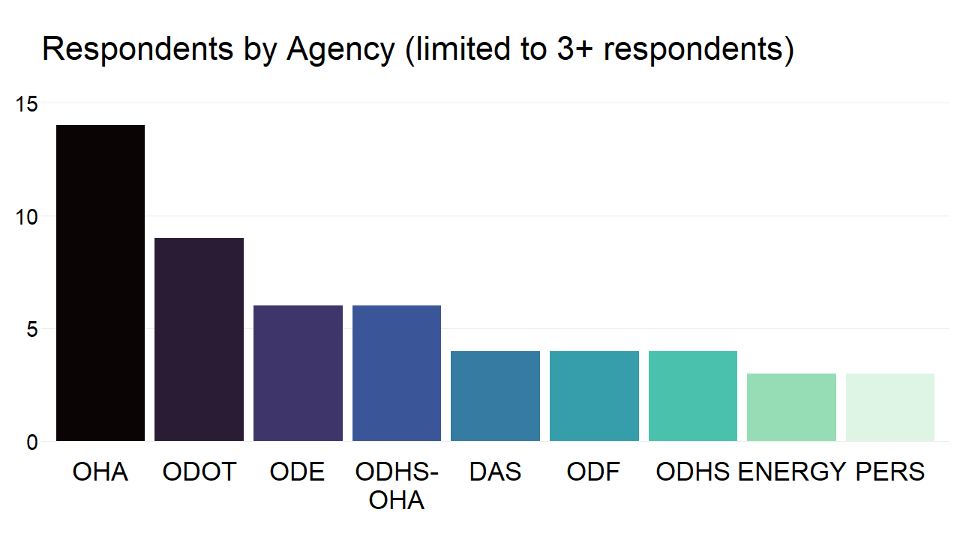

Slide 3
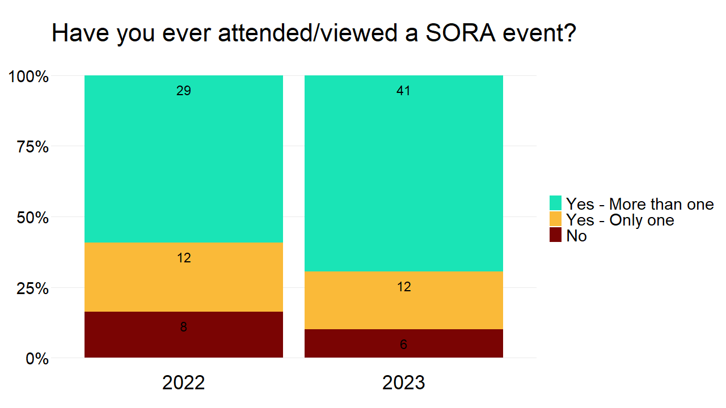
HISTORICAL
DATA

Slide 4
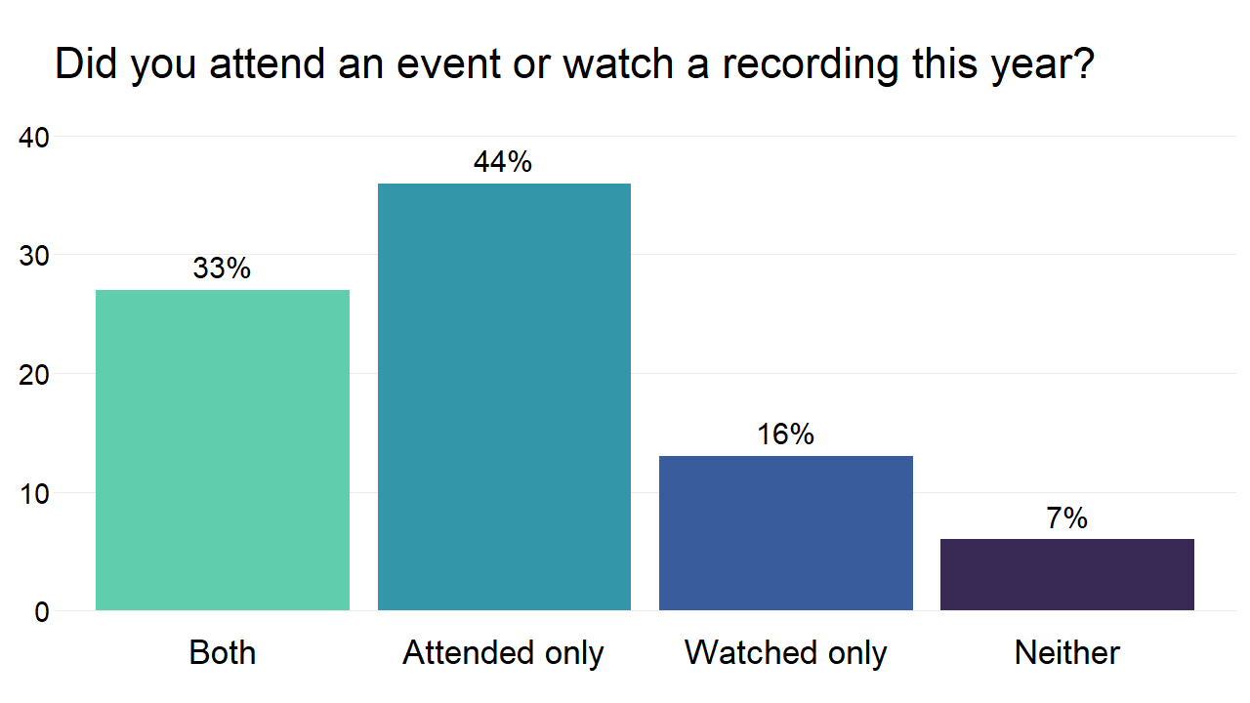

Slide 5
What barriers, if any, prevented you
from participating in SORA events?
Barrier | 2022 | 2023 | 2024
Able to attend all events | 5% | 5% | 2%
Scheduling conflicts | 42% | 55% | 51%
Content did not interest me | 22% | 25% | 21%
Format did not interest me | 3% | 4% | 1%
Wasn’t notified in time | 6% | 4% | 3%
I am new to SORA | 9% | 1% | 23%
Manager did not support me attending | 6% | 1% | 0%
Other | 8% | 5% | 0%

Slide 6
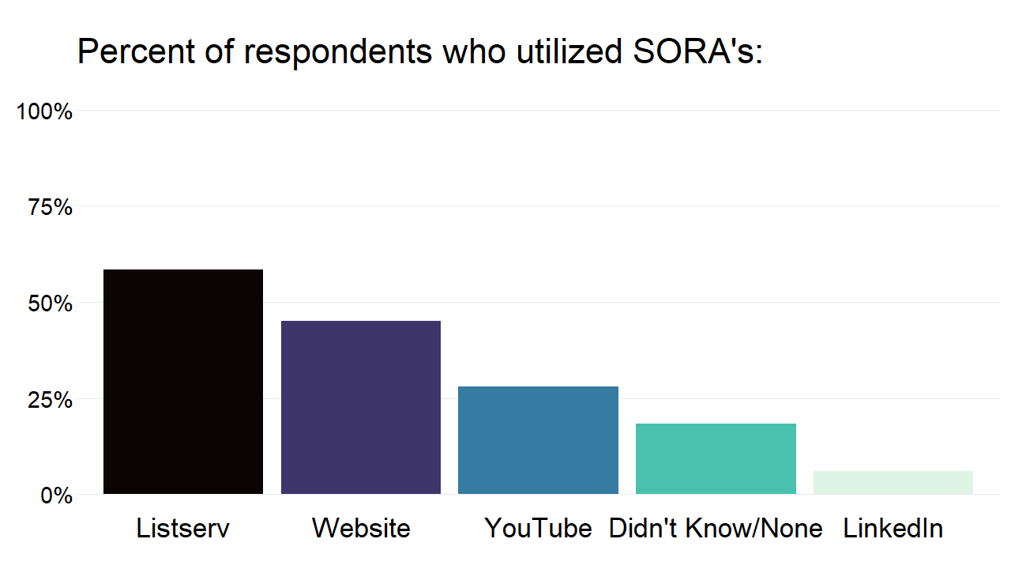

Slide 7
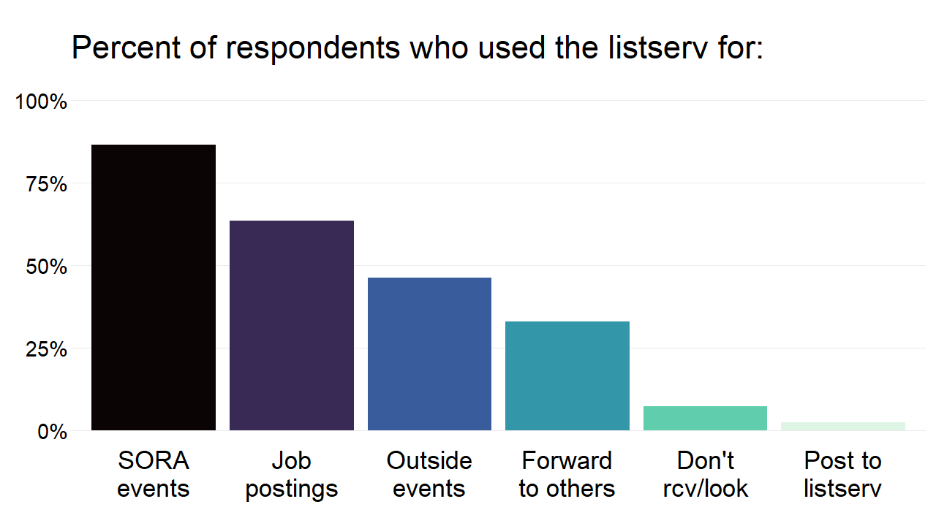

Slide 8
How important are the following benefits?
Benefit | 2022 | 2023 | 2024
Enhancing my current position | 2.5 | 3.0 | 4.1
Advancing my career | 2.4 | 2.4 | 3.8
Expanding my network | 2.7 | 2.8 | 3.7
Knowledge of research, data, stats | 3.2 | 3.3 | 4.3
Knowledge of techniques and software | 2.9 | 3.0 | 4.0

Slide 9
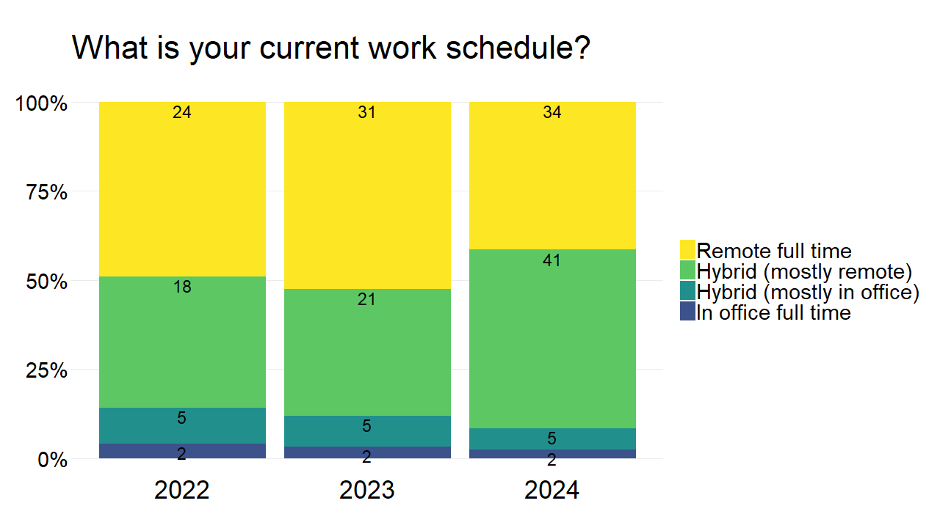

Slide 10
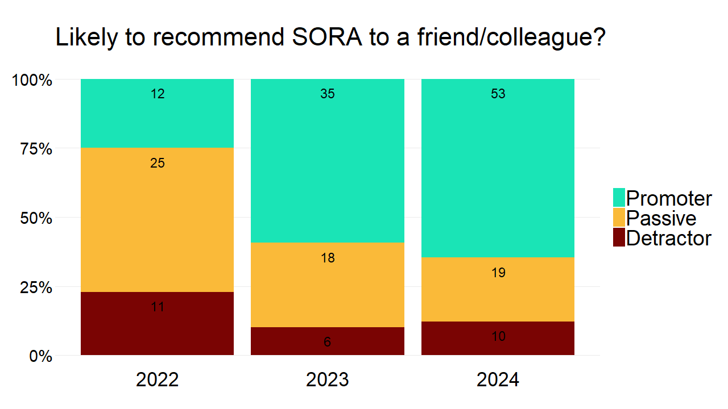

Slide 11
Comments
As a fiscal analyst I appreciate growing within my role through MS 365 products (Power BI, Excel, etc) and new approaches to budgeting and forecasting. Please continue sharing resources and trainings.
Great way to stay connected and engaged w/ other colleagues around the state agencies and external research partners.
I am a bit of an interloper as I work at a county instead of a State agency, but getting to listen in and attend these meetings brings so much value and I appreciate that these exist and are available to non-State folks
Keep up the great job that you're doing. Life long learning is a great as we embrace the day to day challenges and plan for the future! Thank you for all that you do.
My manager forwarded me the digital accessibility session, which was great. Otherwise I'm unfamiliar with the organization. I just signed up for the listserv.
SORA is incredibly helpful! Looking forward to continuing to attend for professional development.
SORA rocks! Keep up the good work. Another benefit I'd add is mentoring and sharing my knowledge to help guide/support/level-up others. :)
"I work in a WOC HR Role, and the tech skills are very low in my department, so this is nowhere on the radar...now it will be!It would be great if the slides could be sent to the people registered, but I will keep my eyes open for them to be posted to the SORA site. Thanks!"

Slide 12
Suggestions
I'm more interested in in-person events
It might be good to have a session or share info about classes/conferences for folks who don't do data analysis or research in their current job but would like to develop skills in it, learn more, do more along those lines, etc. Or maybe there could be a mentorship thing created within the group. Thanks.
Nice job on the survey! I really appreciate SORA and have recommended it to several colleagues. Unfortunately, the SORA site gets blocked on State computers (it is possible to access it but you have to do some clicking). Keep up the great work!
Not sure if it is fixed, but in the past when I have tried to link people to SORA's website, I (they) get a https error where oregonresearch.org is not secure. Not sure if this has been corrected yet.
Thank you for this group. I would appreciate more examples and/or presentations in programming. I really enjoyed the R examples and would appreciate additional examples of R and Python.
Would like to see more career pathways, education and resources
Would love to see some asset management topics at some point to connect and network with other agencies' asset management teams :)

