Slide 1
Welcome to the SORA Spring 2024 Event
Can’t stay? That’s okay!
The recorded event will be posted to our YouTube channel,
with the link and other materials on our website: oregonresearch.org
Join our new LinkedIn Group for discussion, help, and networking!
Search “State of Oregon Research Academy” or go to
linkedin.com/groups/14414150
Let us know what you want to see from future events by emailing us:
ORresearchacademy@gmail.com

Slide 2
Intro to Excel Macros
Michael Metiva
Research Analyst, Oregon DOR
SORA Spring Event, 3/21/2024

Slide 3
What are macros?
“An action or set of actions that you can run as many times as you want.” – Microsoft Support
Macros help automate repetitive tasks:
Sorting and converting data
Formatting tables for reports
Pulling information from other spreadsheets

Slide 4
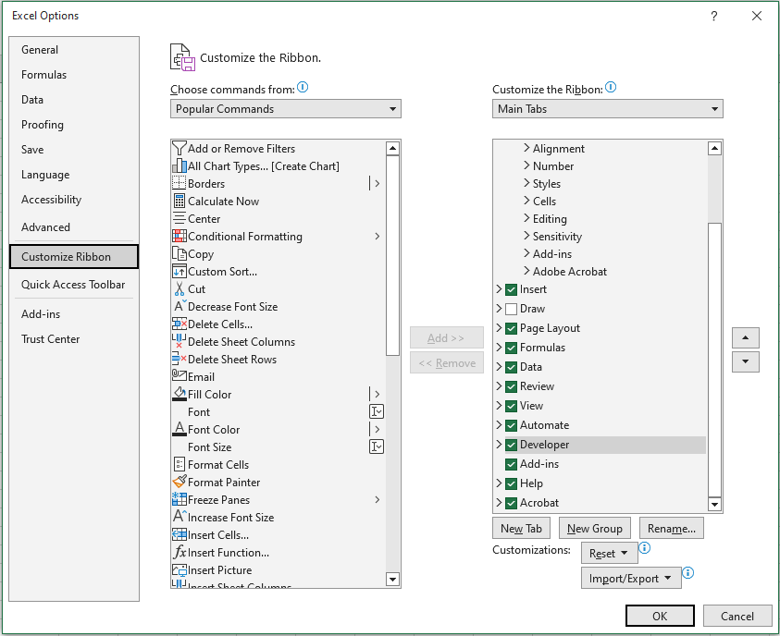
How do I access macros in Excel?
Show the Developer Tab (File > Options)

Slide 5
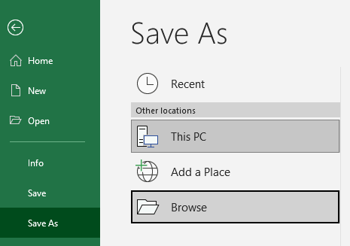
How do I access macros in Excel?
Save as macro-enabled workbook (.xlsm)

Slide 6
How do I create a macro?
Record specific keystrokes and mouse clicks
Simpler, but limited
Use Visual Basic for Applications (VBA) programming to “simulate” keystrokes and mouse clicks
More complex, more flexible

Slide 7
Recording a macro
Example using mtcars dataset:
Keep only car, cyl, hp, qsec, and am columns
Revalue am column
Rearrange to make qsec final column
Sort by qsec (low to high)
Rename all columns and bold the headers

Slide 8
Limitations of recorded macros
All operations are bound to specific rows, columns, and cells with no regard for contents
Appropriate if datasets have consistent dimensions and organization, e.g., a monthly report with 5 statistics from each of 10 divisions (10 rows by 5 columns every time)
Some operations (e.g., sorting/filtering) are bound to the specific sheet used during recording
Can work around this by designating a “workspace” sheet within your workbook, then copying results out

Slide 9
Quick Break: VBA basics

Slide 10
VBA Basics
Sub (subroutine): bookends the code
Defines the start and end of a specific set of actions that should be run together
Dim (dimension): declares variables and their types
Dim lastRow As Integer
Dim debtAmount As Currency
Dim eventDate As Date
Code generally structured as selections (workbook, worksheet, range of cells) then actions, separated by periods
Worksheets("Sheet1").Cells(5,3).ClearContents
ActiveSheet.Range(“B2”) = “test”

Slide 11
First few lines of recorded macro
Sub mtcarsFormat()
' Keep car, cyl, hp, qsec, am. Revalue am. Make qsec …
Range("B:B,D:D,F:F,G:G,I:I,K:K,L:L").Select
Range("L1").Activate
Selection.Delete Shift:=xlToLeft
Range("F1").Select
ActiveCell.FormulaR1C1 = "Transmission"
Range("F2").Select
ActiveCell.FormulaR1C1 = "=IF(RC[-1]=0,""Automatic"",""Manual"")"
Range("F2").Select
Selection.AutoFill Destination:=Range("F2:F33"), Type:=xlFillDefault

Slide 12
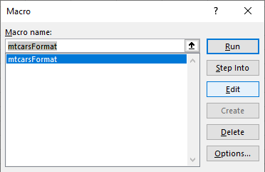
Editing an existing macro
Dev Tab > Macros > Edit to inspect and change code
Example: edit “mtcarsFormat” macro
Change quarter mile time to descending

Slide 13
Creating a new VBA macro
Example using mtcars dataset:
Import the mtcars dataset from the CSV
Highlight blank cells
Save workbook as XLSX with timestamp in the name

Slide 14
Question Break
Bonus: Put any ideas you have for using macros in the chat

Slide 15
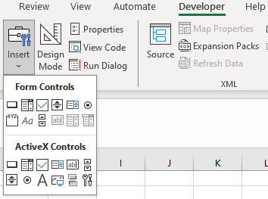
Buttons
Make workbook more user-friendly by running macros from buttons
Insert a button into the sheet
In the Assign Macro window, select a macro for the button or write a new macro
Right-click the button to rename, reassign a macro, or format the button/text

Slide 16
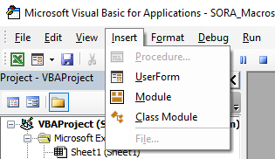
UserForms
Regulate and speed up data input with UserForms
In the VBA editor, click Insert > UserForm
Add controls and labels to create a form, including a submit button
Write initialization/submission VBA code as needed
Add button to sheet to open UserForm for easy access

Slide 17
Final notes
Google and StackOverflow are your friends!
Some VBA concepts worth exploring:
With – performing several operations on the same object/selection
If/Then/Else – conditional values or formatting
For/Next – looping through rows, columns, values, etc.
Join the “State of Oregon Research Academy” LinkedIn group for additional help, discussion, and networking!
https://www.linkedin.com/groups/14414150/

