Slide 1
Financial and Social Costs of Returned Mail
Taxpayer Advocate Office
12/8/2022
Michael Metiva

Slide 2
Agenda
01 Problem Summary
02 Returned Mail Procedures
03 Financial Costs
04 Social Costs
05 Recommendations

Slide 3
Problem Summary
5.8 million mail items per year
200,000 – 400,000 returned undeliverable
Collection delays, lost appeals, extra penalties, etc.
Notes:
DOR initiates contact almost exclusively by mail… 5.8 million…
All sorts of issues that slow down DOR processes and reduce voluntary compliance without even involving the taxpayer (no chance to comply).
Diving deeper into where this returned mail is coming from…

Slide 4
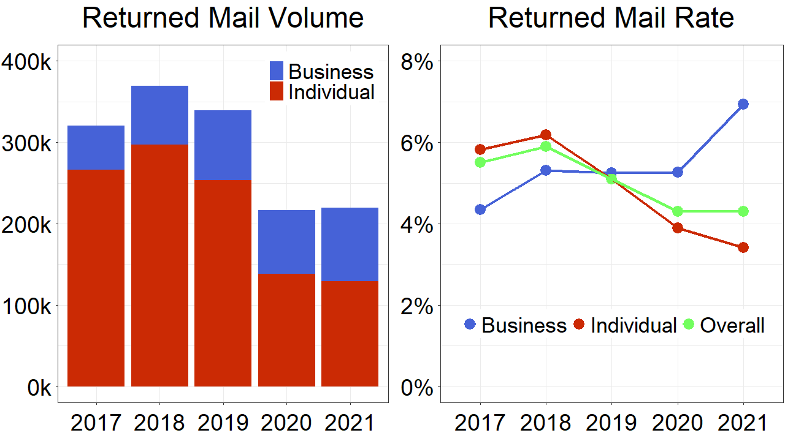
Notes:
Most of the volume from individuals, but returned mail rate for individuals’ mail fell in 2020 and 2021.
This likely due to systematic changes in how GenTax handles SOA docs (most common type of returned mail).
Issue less often (2019) and prevent generation after mail returned (2020).

Slide 5
Returned Mail Procedures
Letters scanned into GenTax, shredded
“Returned Mail” + “Stop Stm”
Addresses updated when tax returns filed
Systematic updates
IRS Master File, USPS yellow label addresses upon return
Address verification letters (“R U There?”)
Notes:
In my research, I found it helpful to compare DOR procedures around returned mail to those found in the IRS’s internal revenue manual.
This comparison highlighted some weaknesses, namely that we have limited systems for updating addresses outside annual returns.
We obviously can’t track addresses with perfect accuracy no matter the procedures, but there’s a lot of room for improvement, specifically with what’s called… (“known bad addresses”)

Slide 6
“Known Bad Addresses”
Mail Sent to
Address on File
Mail Returned Undeliverable
More Mail Sent to “Known Bad Address”
Notes:
“Known Bad Addresses”
I estimated the amount of mail returned from known bad addresses…

Slide 7
Financial Costs: DOR
Returned Mail from Known Bad Addresses
 | Total Mail Returned | Mail Returned from Repeat Address* | Minimum Known Bad Address Rate | Estimated Cost of Known Bad Address Mailing
2017 | 321,602 | 203,455 | 63% | $610,365
2018 | 370,432 | 262,276 | 71% | $786,828
2019 | 339,856 | 241,869 | 71% | $725,607
2020 | 217,084 | 145,158 | 67% | $435,474
2021 | 220,029 | 149,492 | 68% | $448,476
Notes:
…by estimating amount of mail returned from a given addresses repeatedly.
Two assumptions built in, both downward pressure on number (establishing min rate)
Mailings to same address on same day counted as one (if 3 mail items sent in one day…)
Tracking unique addresses started with transition to using GenTax in mid-2016, partial data.
Using these numbers…

Slide 8
Financial Costs: DOR
Returned Mail from Known Bad Addresses
 | Total Mail Returned | Mail Returned from Repeat Address* | Minimum Known Bad Address Rate | Estimated Cost of Known Bad Address Mailing
2017 | 321,602 | 203,455 | 63% | $610,365
2018 | 370,432 | 262,276 | 71% | $786,828
2019 | 339,856 | 241,869 | 71% | $725,607
2020 | 217,084 | 145,158 | 67% | $435,474
2021 | 220,029 | 149,492 | 68% | $448,476
Notes:
Using these numbers… mailings to known bad addresses make up at around 2/3 of returned mail.
Using the $3 per returned mail, minimums estimates for direct financial costs are around half a million dollars annually.
Not accounting for other costs like uncollected tax revenue or interest accumulating on refunds owed to taxpayers.

Slide 9
Financial Costs: Taxpayers
“The amount owed [by a taxpayer] can grow as interest and penalties multiply, and the agency may eventually levy assets to pay the debt owed for taxes, penalties, and interest. Taxpayer’s rights to timely appeal may also be jeopardized. If given the opportunity, perhaps many of these open issues would be voluntarily resolved by the taxpayer, if only they were actually receiving the mail that we are sending.”
Notes:
We don’t have a similar dollar estimate for the costs from a taxpayer perspective, but a 2017 internal audit of the DOR’s mail processing noted that…
Continuing to look at this issue from the taxpayer side, we must also consider…

Slide 10
Social Costs
Whose addresses change most frequently?
What are the income demographics of returned mail addressees?
What types of mail are most commonly returned?
Notes:
Social costs, which I looked at from three angles.

Slide 11
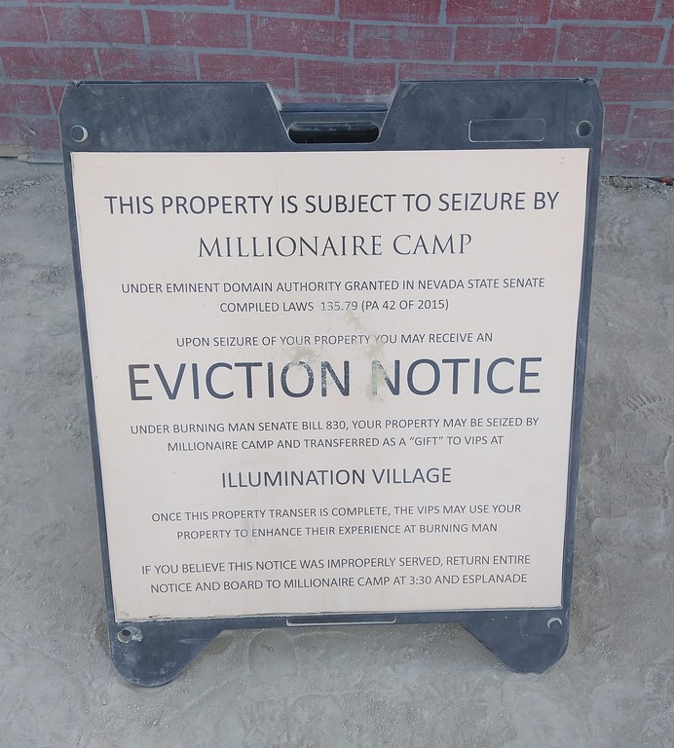
Social Costs: Housing Instability
Mobility/Instability Risk Factors
Low income
Renting rather than owning
Union/partnership dissolution
Intimate partner violence
Substance abuse disorders
Physical or mental disabilities
This Photo is licensed under CC BY-SA
This Photo is licensed under CC BY-SA
This Photo is licensed under CC BY-SA-NC
Notes:
When looking at whose address changes most frequently, researchers have identified a number of risk factors.
One researcher summarized this: in general, housing instability and mobility is associated with…

Slide 12
Social Costs: Housing Instability
DEPLETION OF SOCIAL + FINANCIAL RESOURCES
Mobility/Instability Risk Factors
Low income
Renting rather than owning
Union/partnership dissolution
Intimate partner violence
Substance abuse disorders
Physical or mental disabilities
This Photo is licensed under CC BY-SA
This Photo is licensed under CC BY-SA
This Photo is licensed under CC BY-SA-NC
Notes:
…the depletion of social and financial resources.
This is borne out in part by data from individual tax returns…

Slide 13
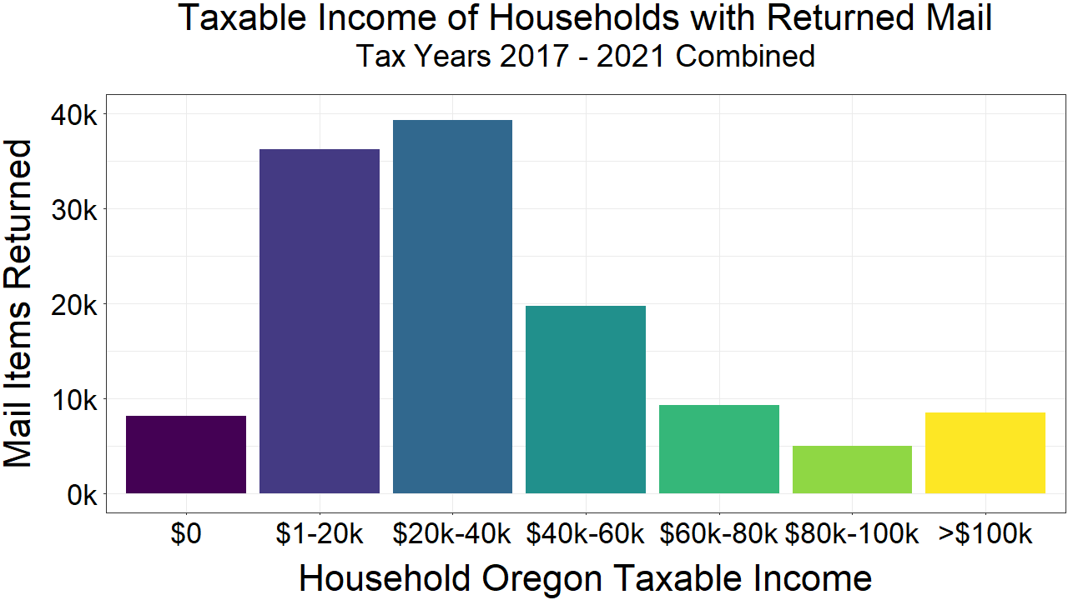
Notes:
From 2017 to 2021, over 66% of returned mail shown here was associated with households with taxable incomes of less than $40k. ~6% no reported household taxable income.
This graph is skewed a bit toward low income. Data comes with a major caveat, though…

Slide 14
*only 12%
Notes:
…only 12% of the returned mail could be matched to a tax return for the same year.
The remaining 88% was sent to people who didn’t file; nonfilers tend to be very low-income people who may not be required to file.

Slide 15
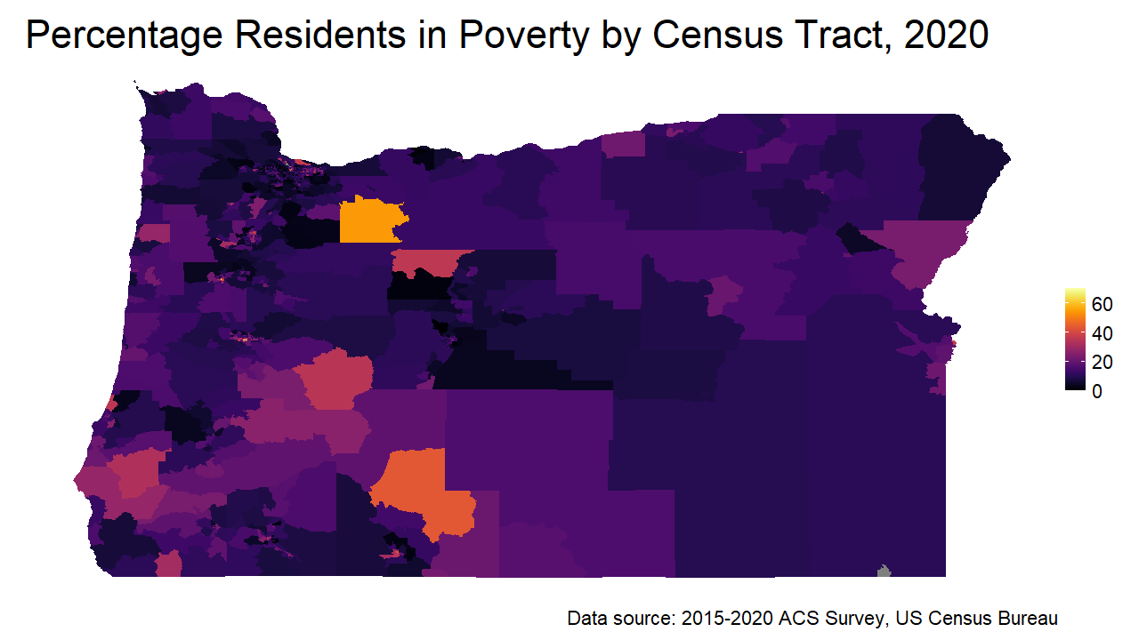
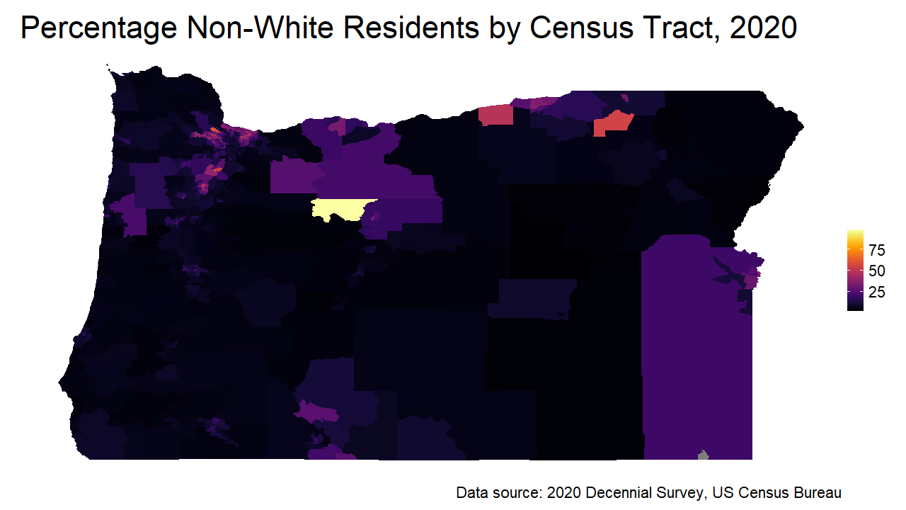
All tract median: 10.9% poverty
Addressee tract median: 12.9% poverty
Distributions significant different:
Wilcoxon Signed-Rank Test p < 1E-9
All tract median: 11.5% non-white
Addressee tract median: 16.0%
Distributions significant different:
Wilcoxon Signed-Rank Test p < 1E-15
Notes:
I won’t talk about it too much as I haven’t completed analysis, but did match random sample of ~3k addresses to census tracts.
Compared income, poverty, and race distributions between all tracts and address data.
Moving on, I also looked at…

Slide 16
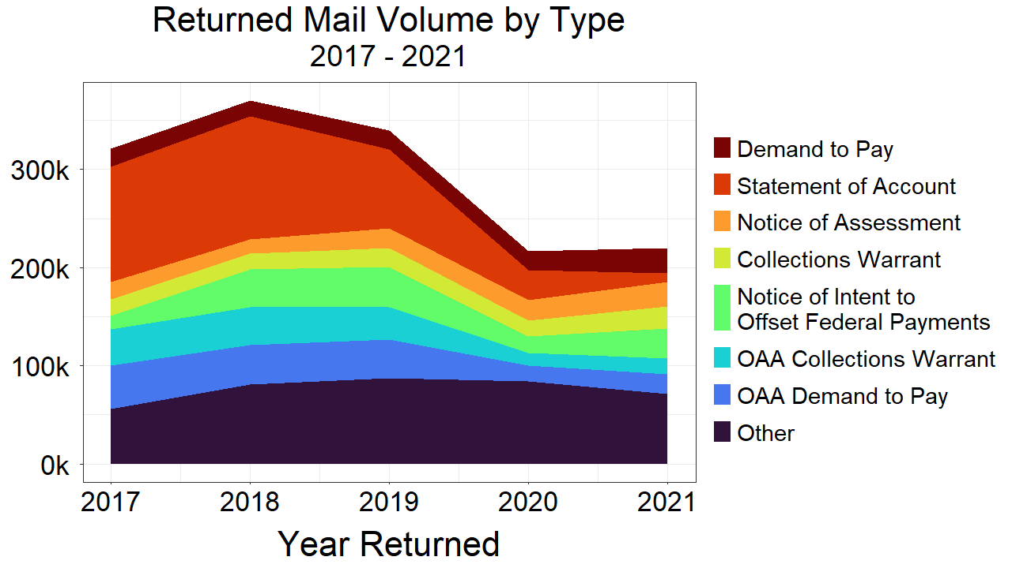
Notes:
…types of mail being returned.
These top mail types constituted at least 5% of the returned mail in any given year. All deal with debt and collections.
All five of the mail types with over 20% returned rates also deal with debt and collections.

Slide 17
Social Costs
Marginalized & vulnerable groups have higher rates of mobility.
Returned mail addressees skew toward low income / non-filing.
Mail regarding debts / assessments are most commonly returned.
Notes:
So summarizing the social costs –
#1 While taxpayers are legally responsible for maintaining a current address, that burden and the effects of not doing so are distributed very unequally.
#2/3 Those least able to pay and least able to afford missed appeal dates are missing mail primarily regarding such debts. This also slows the DOR’s own collections efforts, AND conflicts with other priorities:
Taxpayer rights to know, right to appeal.
DOR vision: To create a clear and easy experience for our customers.
DOR values: Earn the trust of taxpayers. Build partnerships. Do the right thing.

Slide 18
Recommendations
Tweak GenTax indicators and processes to push address updates when mail returned
Adopt systematic address updates >1x / year (e.g., USPS)
Make updating addresses easier in RevenueOnline
Notes:
Broad strokes.

Slide 19
Questions?
Michael Metiva
Michael.METIVA@dor.oregon.gov

