Slide 1
Data literacy program idea
4 pillars that are the foundation for data literacy
Data analysis
Data presentation
Data value
Data access
Notes:
The EC has started to think about 2021. It's likely that we'll continue in a virtual environment for at least the first part of the year. This is our first virtual event. We're hoping that this virtual event series goes well and it's something that we can do again. We've started to think about a data literacy program. It could be a four-part series; one part for each quarter next year. Each part is what I think of as a pillar of data literacy. Those pillars are on the slide.
Data value
Know that data is available or could be collected and appreciate the value it adds to projects.
Data access
Know where to get data and how to extract it, if needed.
Data analysis
Understand what the data means, analyze it, and draw conclusions from it. That may include cleaning, filtering, sorting, aggregating, comparing, and other analytic operations.
Data presentation
Present findings of analysis in a manner and form appropriate to the project and audience. That may be a narrative and/or visualization.

Slide 2
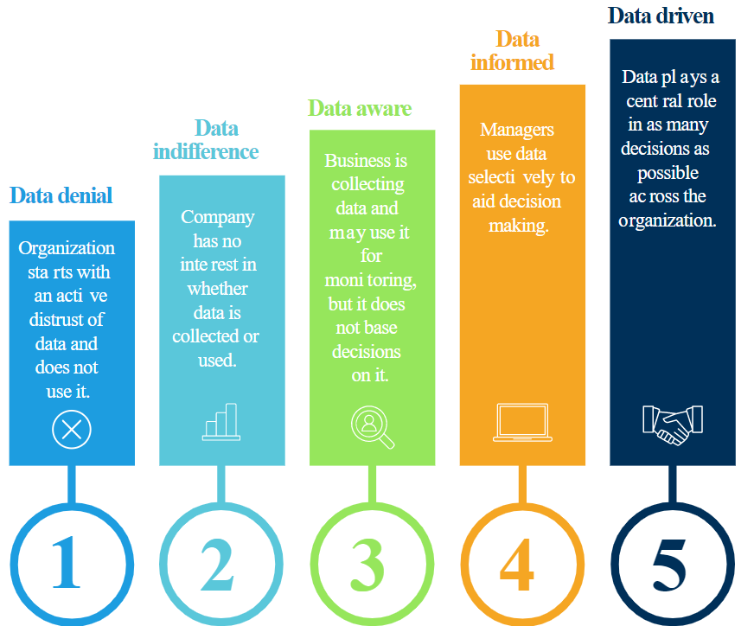
Five stages towards data-driven culture
Source: https://www.smartsheet.com/sites/default/files/IC-Graphic-of-Five-Stages-Toward-Data-Driven-Culture.svg

Slide 3
How to communicate the value of data?
Data is for everyone:
Collaboration and involvement
at all levels in the organization
is key to success.
"Advocate for the use of data throughout each state agency and facilitate data-informed decision-making in all agencies." Oregon’s Data Strategic Plan – Data Practices https://www.oregon.gov/das/OSCIO/Pages/DataStrategy.aspx#principles

Slide 4
How to communicate the value of data?
Goal is to collect relevant and accurate data as well as understand what it means so that we can act on it.
Data can help us understand performance, solve problems, and make more confident and better decisions.
Data can be used to identify trends to help predict what could happen in the future so you can be more proactive about work and problems.
Data can save money.

Slide 5
Discussion We’d like to hear from you!
Do you have a general talking point that you’d add to the list?
Do you have a success story that you’d like to share?
Challenges you’d like to talk through?
This Photo by Unknown Author is licensed under CC BY-NC-ND

